Slide 1
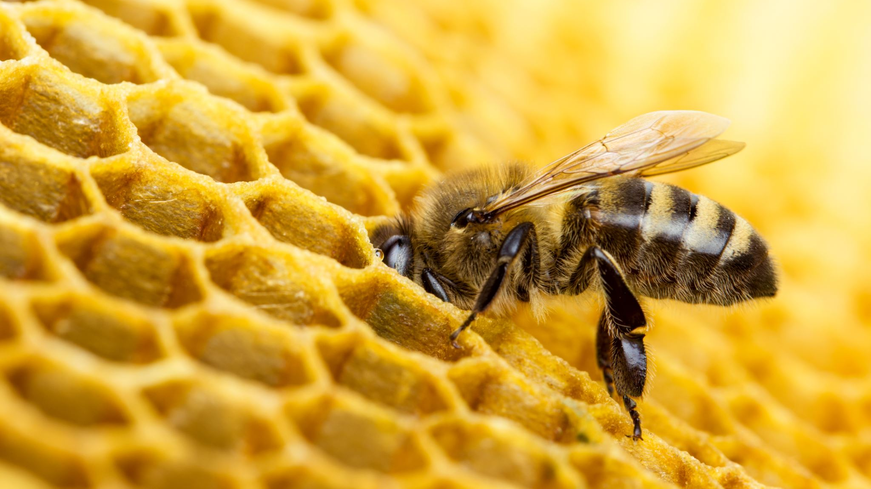
Beehive Density and Honey Purity
Hazel Bunning
Do Countries with Higher Rates of Honey Adulteration Have Fewer Beehives per km²?

Slide 2
AIM
Motivation : honey ranks as the third most adulterated food worldwide (Copeland C., 2020).
Professor Norberto Garcia (2016) highlighted a concerning trend where certain countries appeared to be exporting more honey than could realistically be produced by their available beehive populations.
Objective: Compare number of beehives related to country surface area for
Countries known for honey adulteration : China, Ukraine, India, Viet Nam, Thailand
Countries known for pure honey exports: Argentina, Brazil, Canada, Mexico
Countries where exported honey purity is not defined

Slide 3
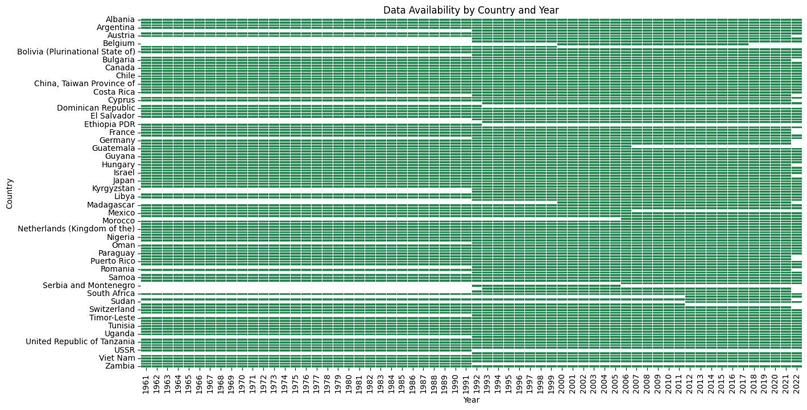
Data
Dowloaded from Food and Agriculture Organization of the United Nations (FAO)
Data spans 1961 to 2022
There are a total of 130 countries or regions, and 6908 non-null entries in the “value” column (see heatmap)
Heat map highlights missing data

Slide 4
Data processing
Countries removed from analysis :
Country | Percentage covered
Belgium | 58
Belgium-Luxembourg | 26
Czechoslovakia | 3
Ethiopia PDR | 3
Guadeloupe | 48
Luxembourg | 71
Martinique | 48
Montenegro | 56
Serbia | 56
Serbia and Montenegro | 45
South Sudan | 35
Sudan | 35
Sudan (former) | 65
Use data from 1992 to 2022
Only countries in which there is at least 80 % of the data.
Divide data into 3 groups of countries :
Group 1: known for honey adulteration (China, Ukraine, India, Viet Nam, Thailand)
Group 2:known for pure honey exports (Argentina, Brazil, Canada, Mexico)
Group 3: all other countries (honey purity not defined)

Slide 5
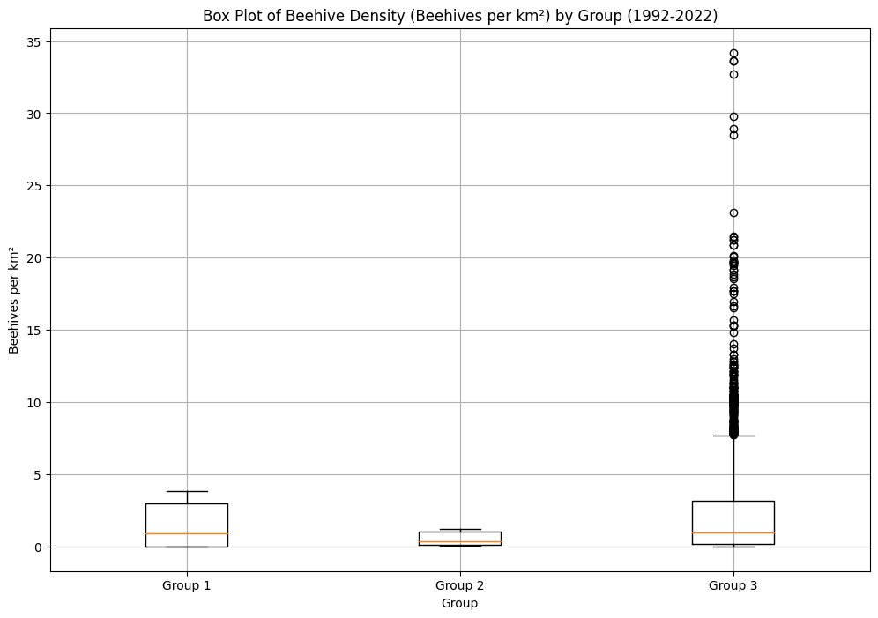
Descriptive Analysis
Beehives per km²
 | Group 1 | Group 2 | Group 3
max | 3.837466 | 1.180728 | 34.19518
min | 0.004121 | 0.050203 | 0
mean | 1.379879 | 0.529031 | 2.334386
median | 0.893309 | 0.351962 | 0.96355
variance | 1.975609 | 0.209536 | 11.68645
std_dev | 1.405563 | 0.457751 | 3.418546
IQR | 2.975621 | 0.924713 | 3.005861

Slide 6
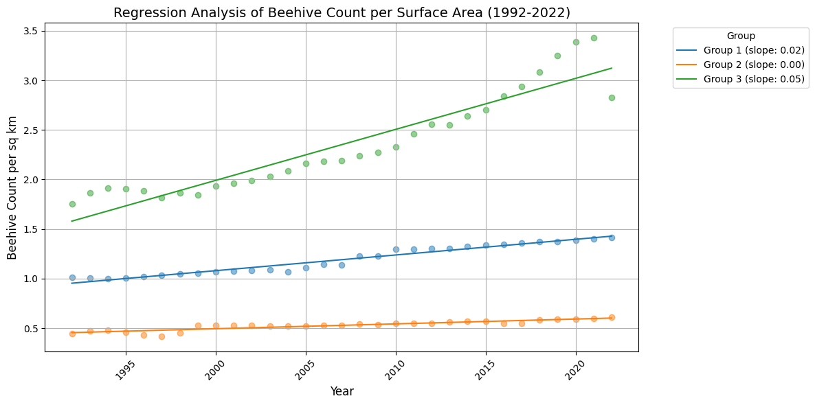
Regression Analysis
Beehives per km² from 1992-2022
Group 1 (countries known for honey adulteration) and Group 3 (other) are seeing an increase in beehive density, but Group 3’s increase is more pronounced.
Group 2 (countries known for pure honey exports) remains stable
The data points align closely with the regression lines. This suggests that the trends in beehive density is consistent over time for each group.

Slide 7
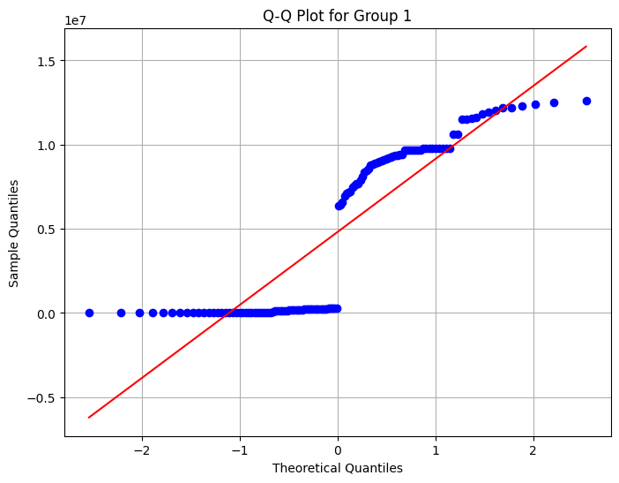
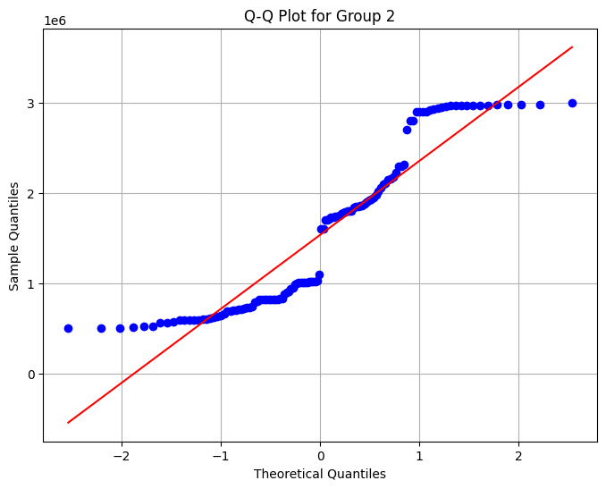
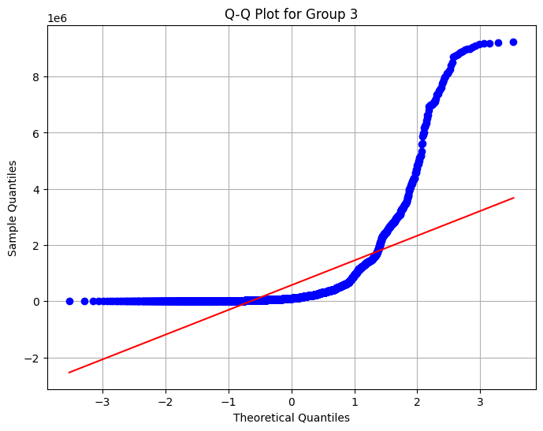
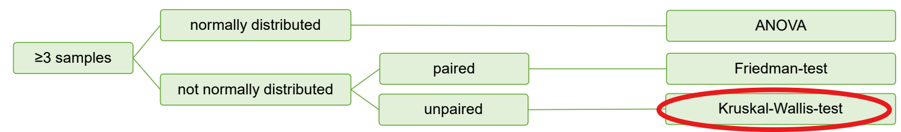
Choosing test
Check for normality

Slide 8
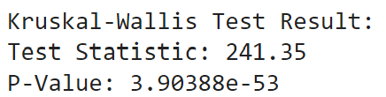
Kruskal-Wallis-test
Null Hypothesis (H0): The density of beehives per area are the same across all three groups. There is no statistically significant difference between the groups.
Alternative Hypothesis (H1): At least one of the groups has a different density of beehive per area. There is a statistically significant difference in the distributions among the groups.
The p-value is less than the significance level (0.05) → reject the null hypothesis (H0) indicating that at least one group differs significantly from the other 2 groups.

Slide 9
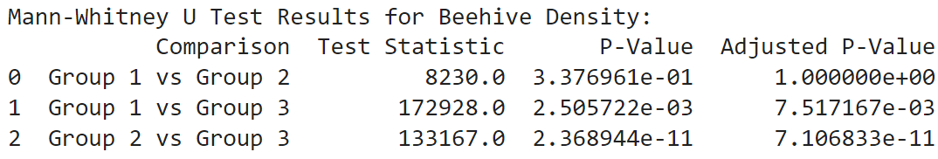
Post Hoc test: Mann-Whitney U test
A non-parametric test suitable for comparing independent samples that do not follow a normal distribution.
The Bonferroni correction was applied to adjust p-values for multiple comparisons, reducing the chance of Type I error.
No significant difference is found between Group 1 and Group 2, this suggests that the beehive densities (beehives per km²) are similar between countries with a reputation for honey adulteration and those exporting pure honey .
Group 3 (other) significantly differs from Group 1 and 2, this suggests that the beehive densities (beehives per km²) are significantly different between these groups.

Slide 10
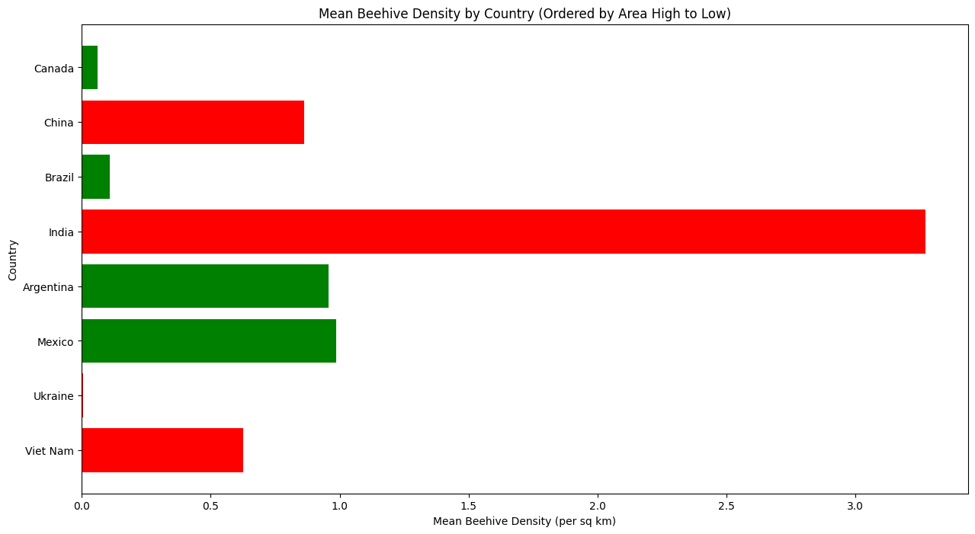
Final thoughts
Country size
Country | Size (km2)
Canada | 9984670
China | 9596961
Brazil | 8515767
India | 3287263
Argentina | 2780400
Mexico | 1964375
Ukraine | 603500
Viet Nam | 331212
Countries known for honey adulteration
Countries known for pure honey exports

Slide 11
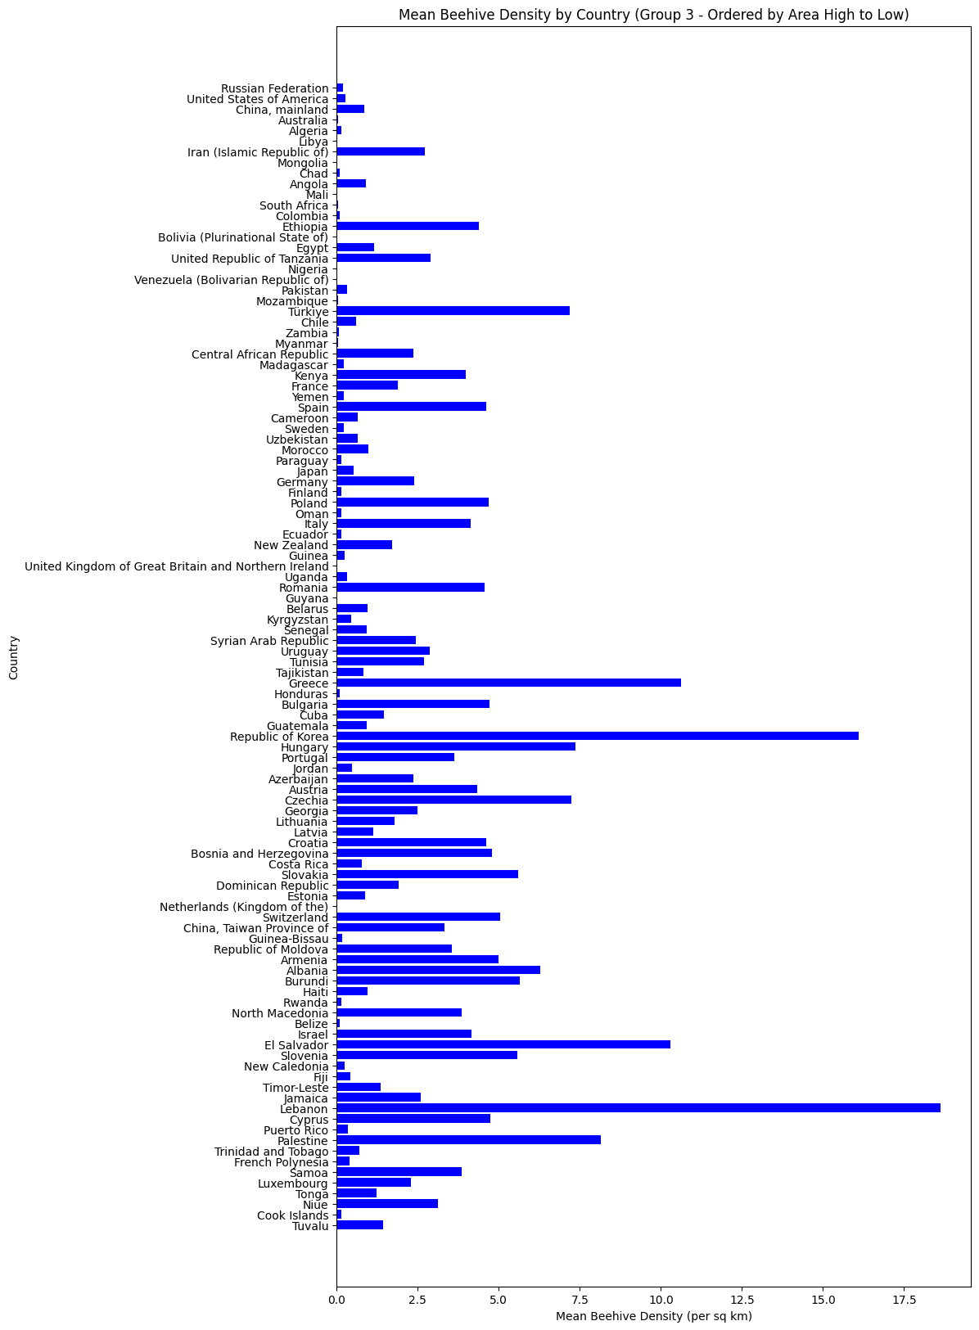
Final thoughts
Variability of beehive density in group 3 – countries ranked by size
Some countries have extreme values which could strongly affect the analysis

Slide 12

Conclusion
Do countries with higher rates of honey adulteration have fewer beehives per km² than with pure honey exports?
There is no significant difference in beehive density between countries that are known for adulteration compared with countries known for pure honey exports
The differences in beehive density between Group 3 (undefined purity) and the other groups could be multifactorial, involving environmental, economic, land use, policy, cultural differences and data quality.
Further investigation into specific countries within Group 3 could provide insights into which of these factors play the most significant roles.

Slide 13
References
García, N. (2016). A study of the causes of falling honey prices in the international market. American Bee Journal, 156(212), 877-882. Available at: https://calgarybeekeepers.com/wp-content/uploads/2018/12/study_causes_falling_honey_prices_international_market.pdf (Accessed: 05 October 2024).
Business Insider. (2020, September). Fake honey: How widespread is the problem and how to spot it. https://www.businessinsider.com/fake-honey-problems-how-it-works-2020-9 (Accessed: 06 October 2024).F
AO. (n.d.). FAOSTAT: Crops and livestock products database. https://www.fao.org/faostat/en/#data/QCL (Accessed: 05 October 2024).

